Slide 1

Team Name: RUGVED
Team Members: Abhigyan, Arnav, Harshal, Siddharth
College Name: Manipal Institute of Technology

Slide 2
Problem Statement:
How does inclusion of AI in agriculture give rise to new sustainable and efficient models ?
Problem Description:
unforeseen changes in weather , inaccurate soil information and cultivation of unsuitable crop and improper detection of plant health are few of the most common nightmares farmers face.

Slide 3
While Artificial Intelligence was always the fastest growing sector, agriculture has been slowest sector in modern days. A fusion of these two sectors would ease life of many.
To make the lives of our farmers easy, we have devised few solutions to the above problems:
We have developed an algorithm which predicts the type of soil , with just a picture.
We have developed a model that can predict the type of crop that is best suited for the soil based on the given parameters.
We have reduced the ambiguity regarding the health of plant by developing an algorithm which predicts if the plant is healthy or unhealthy.
To top it off we have created a user-friendly app which even a commoner can use and access all the above-mentioned features.

Slide 4
Weather status
Price prediction
Soil Classification
SOLUTIONS
Crop health Status
Crop Recommendation
Android App

Slide 5
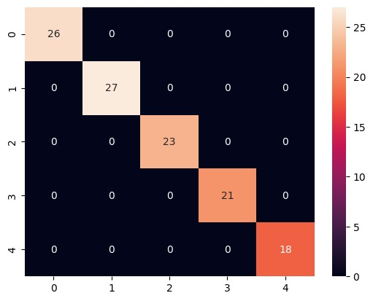
Model Description:
Soil Classification:
Based on our research, we have found several types soil in India. Hence developed an algorithm using CNN to classify the soil based on the image input.
Major soil classes the algorithm can predict:
"Black Soil“
"Cinder Soil“
"Laterite Soil“
"Peat Soil“
"Yellow Soil"
Accuracy: 94.8%
Loss: 12.6%

Slide 6
Model Description:
Crop Recommendation:
We have developed an algorithm using logistic regression,which can predict the type of
crop which would be best suited based on the soil based on-
1. Nitrogen, Potassium and Phosphorus
2. Temperature
3. Humidity
4. Rainfall
Accuracy of the model: 96.18%

Slide 7
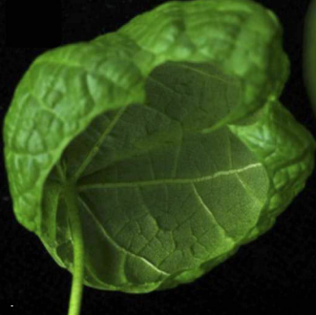
Model Description :
Plant Status:
By observing the photo of a leaf, the algorithm developed by us using CNN, can detect whether a
plant is healthy or not and what type of disease does it have.
Accuracy: 97.4%
Loss: 12.2%
Leaf with curl virus

Slide 8
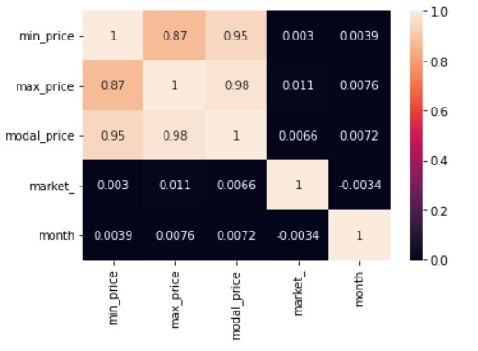
Model Description:
Price prediction :
The algorithm we developed using linear regression can help us in predicting the future prices of the plant or crop.
Accuracy – 99.4%

Slide 9
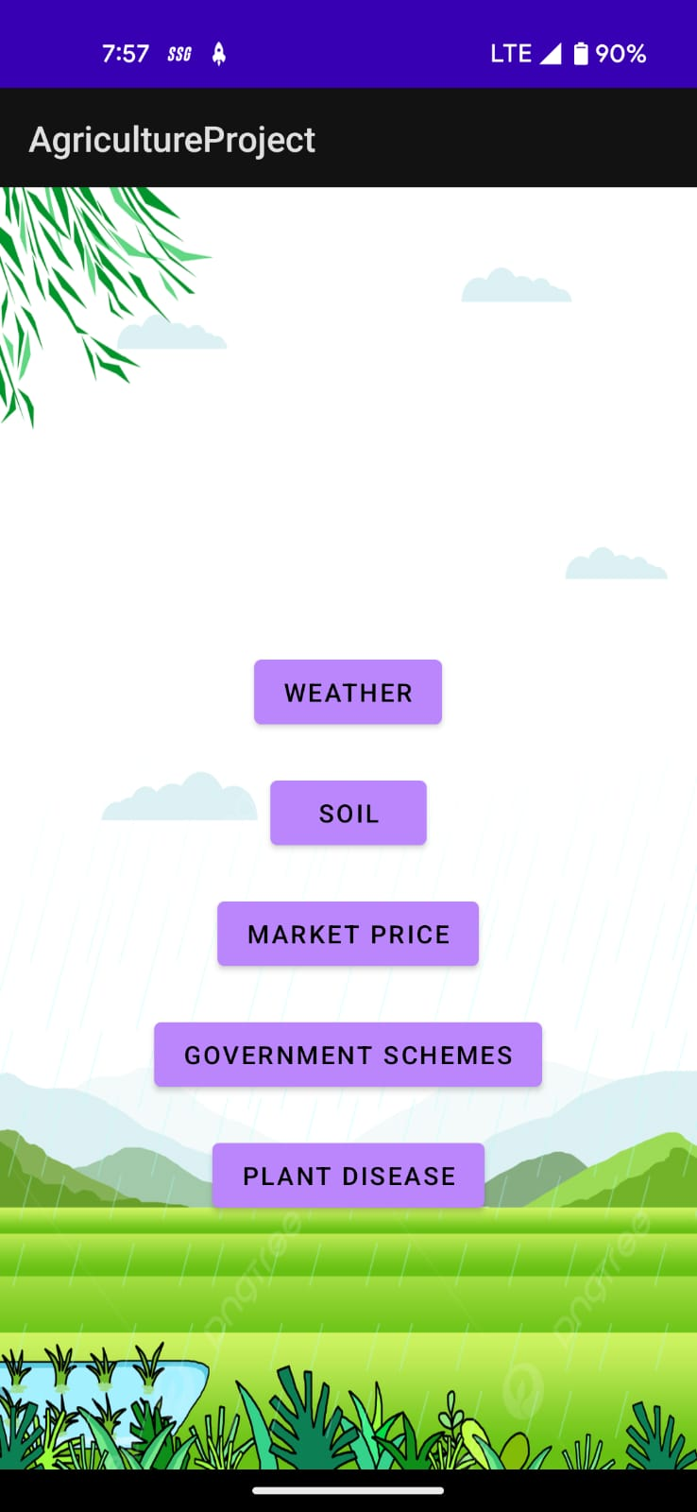
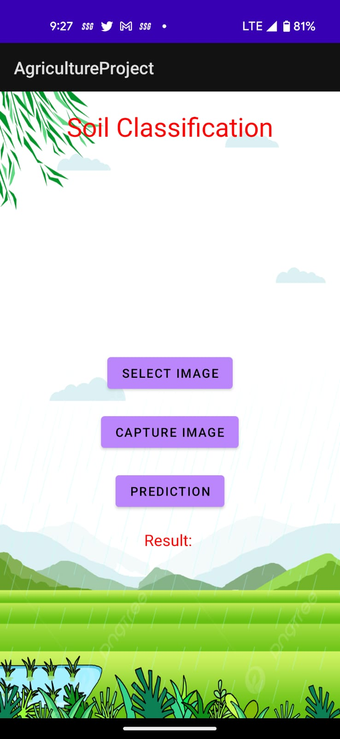
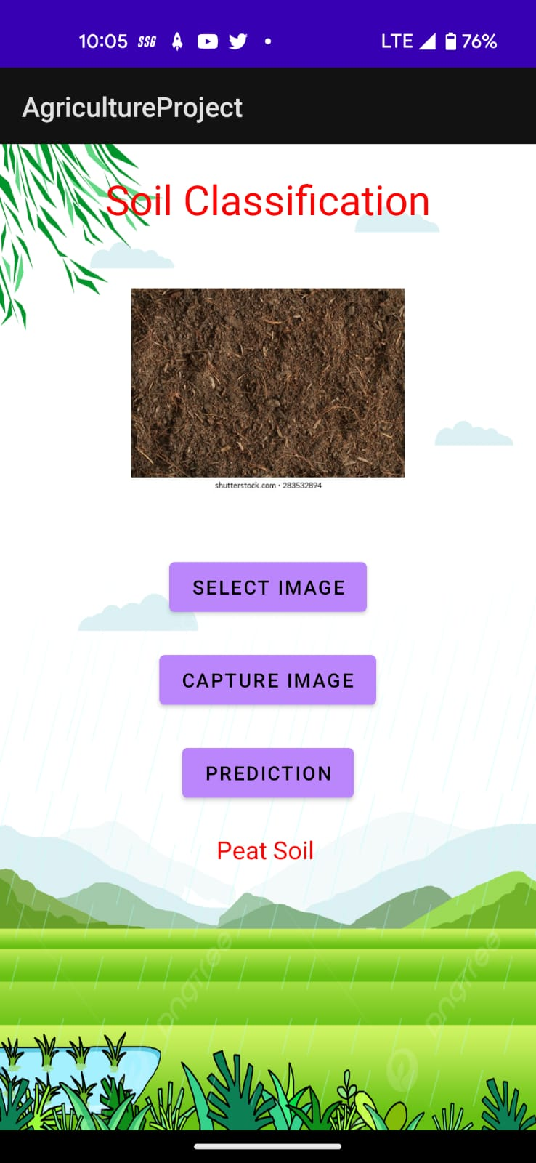
Android studio to the rescue!!
Prototype of the app
Load image

Slide 10
Future prospective:
Advancement of the APP, improving user interface.
Adding more types of crop disease to the model.
Inclusion of more soil types in soil classification.

Slide 11
Dataset (Resources):
https://www.kaggle.com/datasets/atharvaingle/crop-recommendation-dataset
https://www.kaggle.com/datasets/mansijain14/soil-classification-dataset
https://www.kaggle.com/datasets/seroshkarim/cotton-leaf-disease-dataset
https://www.kaggle.com/datasets/syedjaferk/agriculture-commodity-data-2019
Opencv
Machine learning ( Linear & logistic regression models)
Deep learning(CNN classification)
Basic math libraries [pandas, numpy, matplotlib]
Android studio using java
Tensorflow using keras
Sklearn library

Slide 12
Something about us
RUGVED is a multi disciplinary student project located at MIT , Manipal.
We are sophmore year students from MIT aming to be a better version of ourselfs and be a part of a cherished community that helps the backbone of our nation.
THANK YOU

